Slide 1

Find Your Parking Space
Department of ECE
Presented By:
Avuthu Roopesh Reddy - 24EG504E01
Banala Sanjay Kumar - 24EG504C02
Surishetty Pranav Sai - 24EG504E25
Shaik SayyadPasha - 23EG104c27
Under the guidance of:
Dr. M. Kiran Kumar
Assistant Professor,
Dept. of ECE,
Anurag University

Slide 2
Abstract
This project presents a smart multi-floor parking management system designed to automate vehicle monitoring and enhance safety in commercial parking areas. The system consists of six parking slots distributed across two floors, each equipped with dual IR sensors for accurate vehicle detection. Entry and exit points use additional IR sensors to control a motorized gate based on slot availability. Air quality and safety are ensured through MQ-135 and MQ-2 gas sensors installed on each floor, with a buzzer alert activated during hazardous gas levels. An Arduino Mega 2560 processes all sensor inputs and updates a 20×4 LCD display in real time. The system improves efficiency, reduces human intervention, and enhances safety in modern parking infrastructures.

Slide 3
Problem Statement
Modern commercial parking areas, such as malls and multiplexes, often face issues like inefficient space utilization, traffic congestion at entry and exit points, and difficulty in monitoring slot availability. Manual parking management leads to delays, miscommunication, and inconvenience for users. There is a need for an automated system that can accurately detect vehicle presence, manage gate operations, monitor air quality, and display real-time parking status.

Slide 4
Methodology
The system is developed using a structured methodology beginning with the identification of parking challenges and safety concerns in multi-floor environments. The hardware setup includes installing dual IR sensors in each parking slot for accurate vehicle detection and additional IR sensors at entry and exit points for gate automation. MQ-135 and MQ-2 sensors are placed on each floor to continuously monitor air quality and detect hazardous gases. All sensor outputs are interfaced with an Arduino Mega 2560, which processes the data and updates a 20×4 LCD display in real time. The system activates a buzzer during unsafe gas levels and operates the gate based on slot availability. The complete setup is tested and calibrated for reliability and accuracy.

Slide 5
Advantages:
Fully automated parking management
Reduces human effort and errors
Real-time monitoring of slot availability
Improved safety with gas detection
Faster vehicle movement at entry and exit
Efficient utilization of parking space
Scalable for commercial buildings and malls
Low maintenance and cost-effective hardware
User convenience through immediate visual feedback

Slide 6
Disadvantages:
IR sensors may malfunction in extreme lighting or dusty conditions
Gas sensors require periodic calibration
System depends on continuous power supply

Slide 7
Flow Chart
Update LCD (Display Slot Status)
Start
(Power ON)
Control Gate Motor(Open/Close)
Process Data in Arduino Mega
Read IR Sensors (Slots, Entry, Exit)
End
(Repeat the process)
Read Gas Sensors (MQ-135, MQ-2)

Slide 8
Block Diagram
IR Sensors at parking slots(12)
Entry & Exit
IR Sensor
MQ-135 & MQ-2 in Ground Floor
MQ-135 & MQ-2 in First Floor
Arduino Mega 2560
Display
Entry and Exit Gate
Buzzer

Slide 9
Objectives
To design an automated multi-floor parking system
Develop a system capable of monitoring and managing parking slots across two floors with minimal human intervention.
To detect vehicle presence accurately using IR sensors
Use dual IR sensors for each slot and additional entry/exit sensors to ensure reliable vehicle detection and flow control.
To display real-time parking availability
Show the occupancy status of all slots and remaining free spaces on a 20×4 LCD display.
To ensure safety through gas detection
Integrate MQ-135 and MQ-2 sensors to continuously monitor air quality and detect hazardous gases inside the parking area.
To alert users during unsafe conditions
Activate a buzzer and update the display when dangerous gas levels are detected.
To automate gate operation
Use motor-based gate control that opens and closes automatically based on sensor input and parking availability.
To create an efficient and user-friendly parking experience
Reduce congestion at entry/exit points and improve overall parking management efficiency.

Slide 10
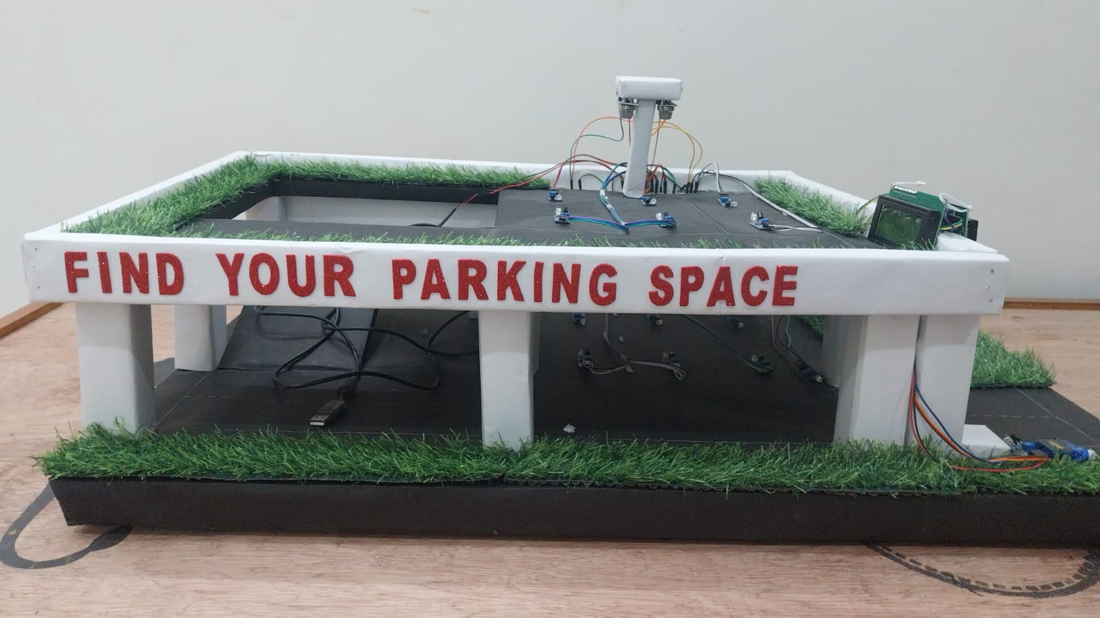
System Designed
Model Designed

Slide 11
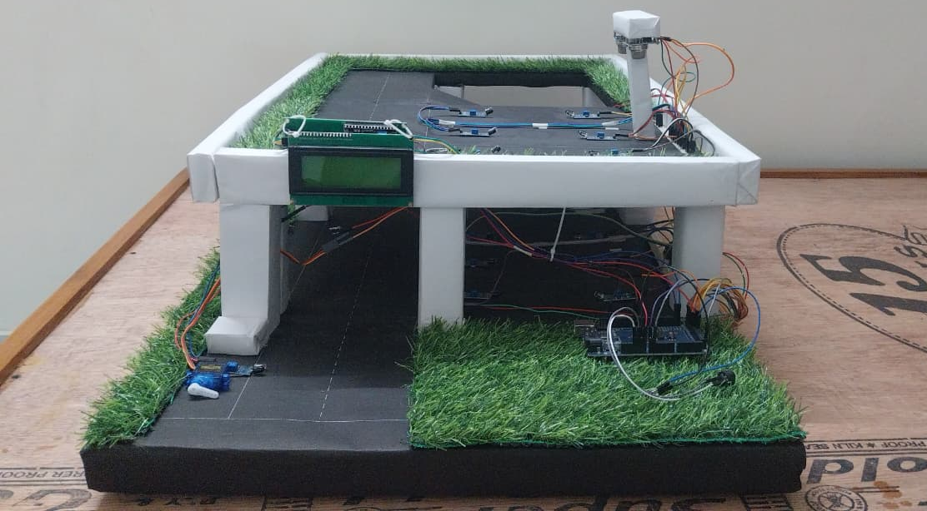
System Designed
Vehicle Entry

Slide 12
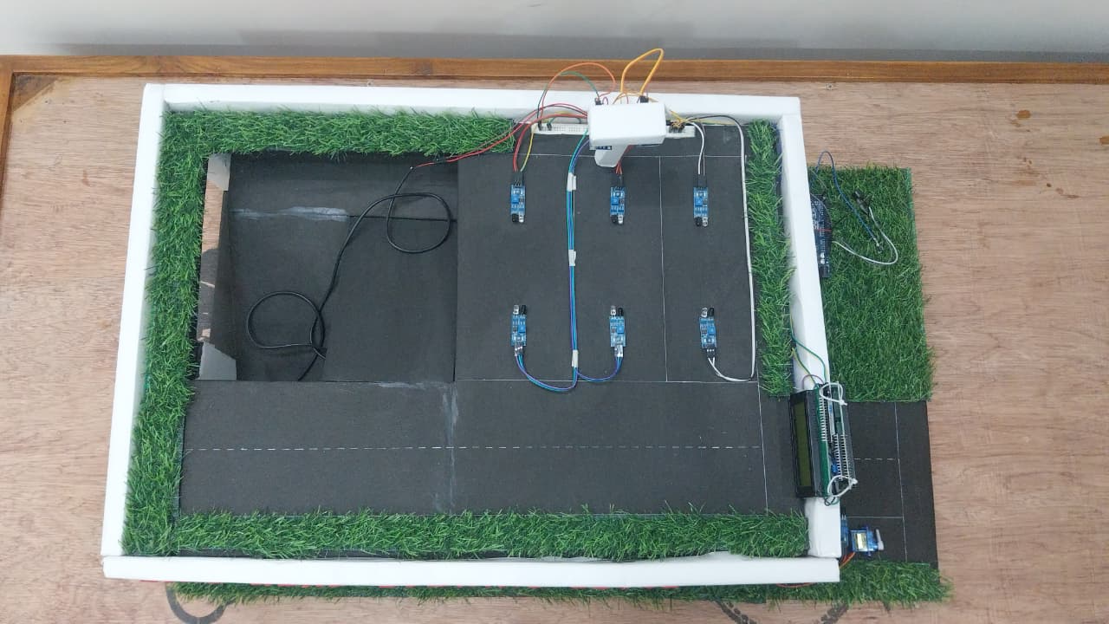
System Designed
Parking Slots

Slide 13
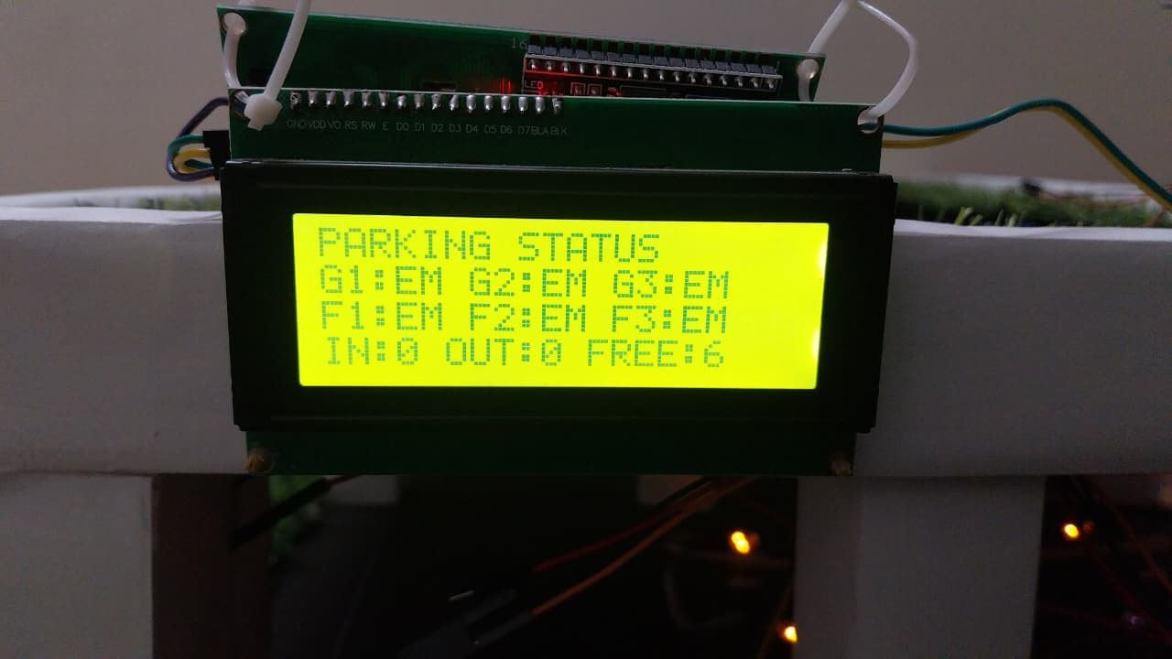
System Designed
Initial Parking Slots

Slide 14
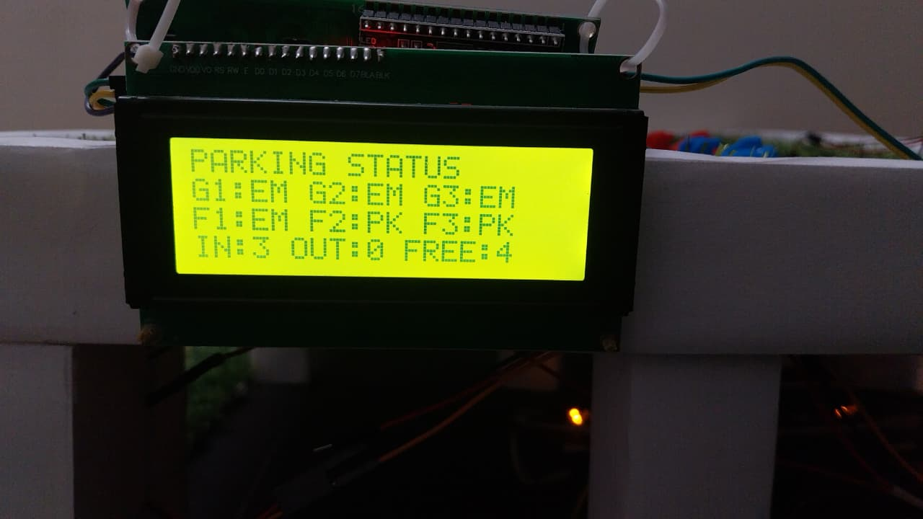
System Designed
After Vehicle Parking Detected

Slide 15
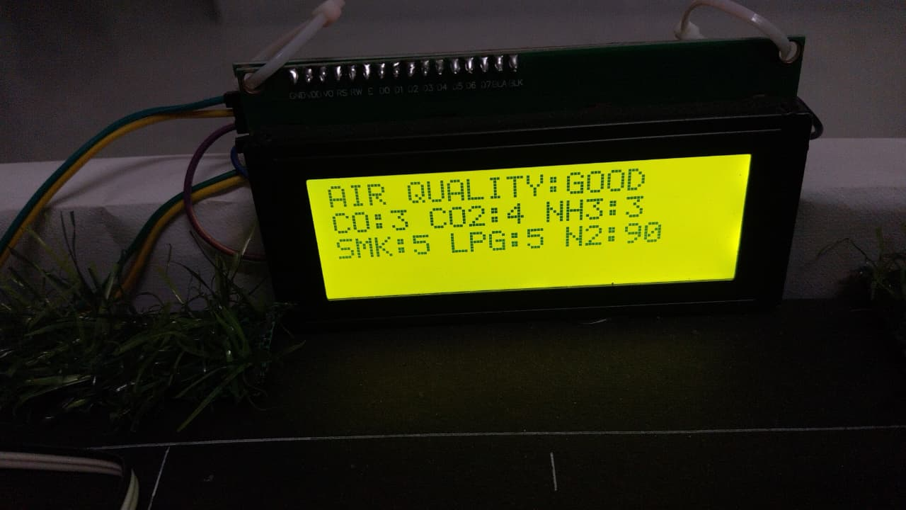
System Designed
Gas Readings

Slide 16
THANK YOU

